Slide 1

Tracing
Chris Piech
CS106A, Stanford University

Slide 2

Learn How To:
Trace programs step by step

Slide 3
Great foundation

Slide 4
Anatomy of a method
public void run() {
double mid = average(5.0, 10.2);
println(mid);
}
private double average(double a, double b) {
double sum = a + b;
return sum / 2;
}

Slide 5
Anatomy of a method
public void run() {
double mid = average(5.0, 10.2);
println(mid);
}
private double average(double a, double b) {
double sum = a + b;
return sum / 2;
}
method “definition”

Slide 6
Anatomy of a method
public void run() {
double mid = average(5.0, 10.2);
println(mid);
}
private double average(double a, double b) {
double sum = a + b;
return sum / 2;
}
Output expected
Input expected

Slide 7
Anatomy of a method
public void run() {
double mid = average(5.0, 10.2);
println(mid);
}
private double average(double a, double b) {
double sum = a + b;
return sum / 2;
}
Return Type
Parameters

Slide 8
Anatomy of a method
public void run() {
double mid = average(5.0, 10.2);
println(mid);
}
private double average(double a, double b) {
double sum = a + b;
return sum / 2;
}
name

Slide 9
Anatomy of a method
public void run() {
double mid = average(5.0, 10.2);
println(mid);
}
private double average(double a, double b) {
double sum = a + b;
return sum / 2;
}
body

Slide 10
Anatomy of a method
public void run() {
double mid = average(5.0, 10.2);
println(mid);
}
private double average(double a, double b) {
double sum = a + b;
return sum / 2;
}
Ends the method and gives
back a single value

Slide 11
Anatomy of a method
public void run() {
double mid = average(5.0, 10.2);
println(mid);
}
private double average(double a, double b) {
double sum = a + b;
return sum / 2;
}
This statement is necessary because average promised to return a double

Slide 12
Anatomy of a method
public void run() {
double mid = average(5.0, 10.2);
println(mid);
}
private double average(double a, double b) {
double sum = a + b;
return sum / 2;
}
method “call”

Slide 13
Anatomy of a method
public void run() {
double mid = average(5.0, 10.2);
println(mid);
}
private double average(double a, double b) {
double sum = a + b;
return sum / 2;
}
arguments

Slide 14
Anatomy of a method
Return Type
Parameters
public void run() {
double mid = average(5.0, 10.2);
println(mid);
}
private double average(double a, double b) {
double sum = a + b;
return sum / 2;
}

Slide 15
Anatomy of a method
public void run() {
double mid = average(5.0, 10.2);
println(mid);
}
private double average(double a, double b) {
double sum = a + b;
return sum / 2;
}
When a method ends it “returns”

Slide 16
Trace
public void run() {
double mid = average(5.0, 10.2);
println(mid);
}
private double average(double a, double b) {
double sum = a + b;
return sum / 2;
}

Slide 17
Trace
Run memory
No variables
public void run() {
double mid = average(5.0, 10.2);
println(mid);
}
private double average(double a, double b) {
double sum = a + b;
return sum / 2;
}

Slide 18
Trace
Run memory
No variables
public void run() {
double mid = average(5.0, 10.2);
println(mid);
}
private double average(double a, double b) {
double sum = a + b;
return sum / 2;
}

Slide 19
Trace
Run memory
No variables
public void run() {
double mid = average(5.0, 10.2);
println(mid);
}
private double average(double a, double b) {
double sum = a + b;
return sum / 2;
}

Slide 20
Trace
Run memory
No variables
public void run() {
double mid = average(5.0, 10.2);
println(mid);
}
private double average(double a, double b) {
double sum = a + b;
return sum / 2;
}

Slide 21
Trace
Run memory
average memory
No variables
a
b
public void run() {
double mid = average(5.0, 10.2);
println(mid);
}
private double average(double a, double b) {
double sum = a + b;
return sum / 2;
}

Slide 22
Trace
Run memory
average memory
a
5.0
b
10.2
No variables
public void run() {
double mid = average(5.0, 10.2);
println(mid);
}
private double average(double a, double b) {
double sum = a + b;
return sum / 2;
}

Slide 23
Trace
Run memory
average memory
a
5.0
b
10.2
No variables
public void run() {
double mid = average(5.0, 10.2);
println(mid);
}
private double average(double a, double b) {
double sum = a + b;
return sum / 2;
}

Slide 24
Trace
Run memory
average memory
a
5.0
b
10.2
sum
15.2
No variables
public void run() {
double mid = average(5.0, 10.2);
println(mid);
}
private double average(double a, double b) {
double sum = a + b;
return sum / 2;
}

Slide 25
Trace
Run memory
average memory
a
5.0
b
10.2
sum
15.2
No variables
public void run() {
double mid = average(5.0, 10.2);
println(mid);
}
private double average(double a, double b) {
double sum = a + b;
return sum / 2;
}
7.6

Slide 26
Trace
Run memory
average memory
a
5.0
b
10.2
sum
15.2
No variables
public void run() {
double mid = average(5.0, 10.2);
println(mid);
}
private double average(double a, double b) {
double sum = a + b;
return sum / 2;
}
7.6

Slide 27
Trace
Run memory
No variables
public void run() {
double mid = average(5.0, 10.2);
println(mid);
}
private double average(double a, double b) {
double sum = a + b;
return sum / 2;
}
7.6

Slide 28
Trace
Run memory
mid
7.6
public void run() {
double mid = average(5.0, 10.2);
println(mid);
}
private double average(double a, double b) {
double sum = a + b;
return sum / 2;
}

Slide 29
Trace
Run memory
mid
7.6
public void run() {
double mid = average(5.0, 10.2);
println(mid);
}
private double average(double a, double b) {
double sum = a + b;
return sum / 2;
}

Slide 30
Trace
Run memory
mid
7.6
public void run() {
double mid = average(5.0, 10.2);
println(mid);
}
private double average(double a, double b) {
double sum = a + b;
return sum / 2;
}

Slide 31
Trace
public void run() {
double mid = average(5.0, 10.2);
println(mid);
}
private double average(double a, double b) {
double sum = a + b;
return sum / 2;
}

Slide 32
Drawing Flags

Slide 33
Drawing Flags

Slide 34
Drawing Flags

Slide 35
Flags
private void drawColombiasFlag() {
// Call drawStripe three times
// with different inputs each time
drawStripe(Color.YELLOW, 0, 0.5); drawStripe(Color.BLUE, 0.5, 0.75); drawStripe(Color.RED, 0.75, 1.0);
}
// Define drawStripe
// drawStripe needs three inputs (which come as variables)
// First a color, then a start (in screen percent) and end y.
private void drawStripe(Color color, double yStart, double yEnd) {
double yStartPx = getHeight() * yStart;
double yEndPx = getHeight() * yEnd;
GRect rect = new GRect(getWidth(), yEndPx - yStartPx);
rect.setColor(color);
rect.setFilled(true);
add(rect, 0, yStartPx);
}
method “definition”

Slide 36
Flags
private void drawColombiasFlag() {
// Call drawStripe three times
// with different inputs each time
drawStripe(Color.YELLOW, 0, 0.5); drawStripe(Color.BLUE, 0.5, 0.75); drawStripe(Color.RED, 0.75, 1.0);
}
Takes three inputs: (1) a color, (2) a fraction start, (3) a fraction end
// Define drawStripe
// drawStripe needs three inputs (which come as variables)
// First a color, then a start (in screen percent) and end y.
private void drawStripe(Color color, double yStart, double yEnd) {
double yStartPx = getHeight() * yStart;
double yEndPx = getHeight() * yEnd;
GRect rect = new GRect(getWidth(), yEndPx - yStartPx);
rect.setColor(color);
rect.setFilled(true);
add(rect, 0, yStartPx);
}

Slide 37
Flags
private void drawColombiasFlag() {
// Call drawStripe three times
// with different inputs each time
drawStripe(Color.YELLOW, 0, 0.5); drawStripe(Color.BLUE, 0.5, 0.75); drawStripe(Color.RED, 0.75, 1.0);
}
Thus, every time the method is called, three inputs must be given!
// Define drawStripe
// drawStripe needs three inputs (which come as variables)
// First a color, then a start (in screen percent) and end y.
private void drawStripe(Color color, double yStart, double yEnd) {
double yStartPx = getHeight() * yStart;
double yEndPx = getHeight() * yEnd;
GRect rect = new GRect(getWidth(), yEndPx - yStartPx);
rect.setColor(color);
rect.setFilled(true);
add(rect, 0, yStartPx);
}

Slide 38
Flags
private void drawColombiasFlag() {
// Call drawStripe three times
// with different inputs each time
drawStripe(Color.YELLOW, 0, 0.5); drawStripe(Color.BLUE, 0.5, 0.75); drawStripe(Color.RED, 0.75, 1.0);
}
Thus, every time the method is called, three inputs must be given!
The method receives the first input in a box (aka as a variable), with the name color
// Define drawStripe
// drawStripe needs three inputs (which come as variables)
// First a color, then a start (in screen percent) and end y.
private void drawStripe(Color color, double yStart, double yEnd) {
double yStartPx = getHeight() * yStart;
double yEndPx = getHeight() * yEnd;
GRect rect = new GRect(getWidth(), yEndPx - yStartPx);
rect.setColor(color);
rect.setFilled(true);
add(rect, 0, yStartPx);
}

Slide 39
A Full Program
public class FactorialExample extends ConsoleProgram {
private static final int MAX_NUM = 4;
public void run() {
for(int i = 0; i < MAX_NUM; i++) {
println(i + "! = " + factorial(i));
}
}
private int factorial(int n) {
int result = 1;
for (int i = 1; i <= n; i++) {
result *= i;
}
return result;
}
}

Slide 40
A Full Program
public class FactorialExample extends ConsoleProgram {
private static final int MAX_NUM = 4;
public void run() {
for(int i = 0; i < MAX_NUM; i++) {
println(i + "! = " + factorial(i));
}
}
private int factorial(int n) {
int result = 1;
for (int i = 1; i <= n; i++) {
result *= i;
}
return result;
}
}

Slide 41
Understand the Mechanism

Slide 42
public void run() {
for(int i = 0; i < MAX_NUM; i++) {
println(i + "! = " + factorial(i));
}
}
i

Slide 43
public void run() {
for(int i = 0; i < MAX_NUM; i++) {
println(i + "! = " + factorial(i));
}
}
i
0

Slide 44
public void run() {
for(int i = 0; i < MAX_NUM; i++) {
println(i + "! = " + factorial(i));
}
}
i
0

Slide 45
public void run() {
for(int i = 0; i < MAX_NUM; i++) {
println(i + "! = " + factorial(i));
}
}
i
0

Slide 46
public void run() {
for(int i = 0; i < MAX_NUM; i++) {
println(i + "! = " + factorial(i));
}
}
i
0

Slide 47
public void run() {
for(int i = 0; i < MAX_NUM; i++) {
println(i + "! = " + factorial(i));
}
}
private int factorial(int n) {
int result = 1;
for (int i = 1; i <= n; i++) {
result *= i;
}
return result;
}
0
i
n
0
result
i

Slide 48
public void run() {
for(int i = 0; i < MAX_NUM; i++) {
println(i + "! = " + factorial(i));
}
}
private int factorial(int n) {
int result = 1;
for (int i = 1; i <= n; i++) {
result *= i;
}
return result;
}
0
i
n
0
1
result
i

Slide 49
public void run() {
for(int i = 0; i < MAX_NUM; i++) {
println(i + "! = " + factorial(i));
}
}
private int factorial(int n) {
int result = 1;
for (int i = 1; i <= n; i++) {
result *= i;
}
return result;
}
0
i
n
0
1
1
result
i

Slide 50
public void run() {
for(int i = 0; i < MAX_NUM; i++) {
println(i + "! = " + factorial(i));
}
}
private int factorial(int n) {
int result = 1;
for (int i = 1; i <= n; i++) {
result *= i;
}
return result;
}
0
i
n
0
1
1
result
i

Slide 51
public void run() {
for(int i = 0; i < MAX_NUM; i++) {
println(i + "! = " + factorial(i));
}
}
private int factorial(int n) {
int result = 1;
for (int i = 1; i <= n; i++) {
result *= i;
}
return result;
}
0
i
n
0
1
1
result
i

Slide 52
public void run() {
for(int i = 0; i < MAX_NUM; i++) {
println(i + "! = " + factorial(i));
}
}
1
i
0

Slide 53
public void run() {
for(int i = 0; i < MAX_NUM; i++) {
println(i + "! = " + factorial(i));
}
}
1
i
0
0! = 1

Slide 54
public void run() {
for(int i = 0; i < MAX_NUM; i++) {
println(i + "! = " + factorial(i));
}
}
i
1
0! = 1

Slide 55
public void run() {
for(int i = 0; i < MAX_NUM; i++) {
println(i + "! = " + factorial(i));
}
}
i
1
0! = 1

Slide 56
public void run() {
for(int i = 0; i < MAX_NUM; i++) {
println(i + "! = " + factorial(i));
}
}
i
1
0! = 1

Slide 57
public void run() {
for(int i = 0; i < MAX_NUM; i++) {
println(i + "! = " + factorial(i));
}
}
i
1
0! = 1

Slide 58
public void run() {
for(int i = 0; i < MAX_NUM; i++) {
println(i + "! = " + factorial(i));
}
}
private int factorial(int n) {
int result = 1;
for (int i = 1; i <= n; i++) {
result *= i;
}
return result;
}
0
i
n
1
result
i
0! = 1

Slide 59
public void run() {
for(int i = 0; i < MAX_NUM; i++) {
println(i + "! = " + factorial(i));
}
}
private int factorial(int n) {
int result = 1;
for (int i = 1; i <= n; i++) {
result *= i;
}
return result;
}
0
i
n
1
1
result
i
0! = 1

Slide 60
public void run() {
for(int i = 0; i < MAX_NUM; i++) {
println(i + "! = " + factorial(i));
}
}
private int factorial(int n) {
int result = 1;
for (int i = 1; i <= n; i++) {
result *= i;
}
return result;
}
0
i
n
1
1
1
result
i
0! = 1

Slide 61
public void run() {
for(int i = 0; i < MAX_NUM; i++) {
println(i + "! = " + factorial(i));
}
}
private int factorial(int n) {
int result = 1;
for (int i = 1; i <= n; i++) {
result *= i;
}
return result;
}
0
i
n
1
1
1
result
i
0! = 1

Slide 62
public void run() {
for(int i = 0; i < MAX_NUM; i++) {
println(i + "! = " + factorial(i));
}
}
private int factorial(int n) {
int result = 1;
for (int i = 1; i <= n; i++) {
result *= i;
}
return result;
}
0
i
n
1
1
1
result
i
0! = 1

Slide 63
public void run() {
for(int i = 0; i < MAX_NUM; i++) {
println(i + "! = " + factorial(i));
}
}
private int factorial(int n) {
int result = 1;
for (int i = 1; i <= n; i++) {
result *= i;
}
return result;
}
0
i
n
1
1
2
result
i
0! = 1

Slide 64
public void run() {
for(int i = 0; i < MAX_NUM; i++) {
println(i + "! = " + factorial(i));
}
}
private int factorial(int n) {
int result = 1;
for (int i = 1; i <= n; i++) {
result *= i;
}
return result;
}
0
i
n
1
1
2
result
i
0! = 1

Slide 65
public void run() {
for(int i = 0; i < MAX_NUM; i++) {
println(i + "! = " + factorial(i));
}
}
private int factorial(int n) {
int result = 1;
for (int i = 1; i <= n; i++) {
result *= i;
}
return result;
}
0
i
n
1
1
2
result
i
0! = 1

Slide 66
public void run() {
for(int i = 0; i < MAX_NUM; i++) {
println(i + "! = " + factorial(i));
}
}
1
i
1
0! = 1

Slide 67
public void run() {
for(int i = 0; i < MAX_NUM; i++) {
println(i + "! = " + factorial(i));
}
}
1
i
1
0! = 1
1! = 1

Slide 68
public void run() {
for(int i = 0; i < MAX_NUM; i++) {
println(i + "! = " + factorial(i));
}
}
i
2
0! = 1
1! = 1

Slide 69
public void run() {
for(int i = 0; i < MAX_NUM; i++) {
println(i + "! = " + factorial(i));
}
}
i
2
0! = 1
1! = 1

Slide 70
public void run() {
for(int i = 0; i < MAX_NUM; i++) {
println(i + "! = " + factorial(i));
}
}
i
2
0! = 1
1! = 1

Slide 71
public void run() {
for(int i = 0; i < MAX_NUM; i++) {
println(i + "! = " + factorial(i));
}
}
i
2
0! = 1
1! = 1

Slide 72
public void run() {
for(int i = 0; i < MAX_NUM; i++) {
println(i + "! = " + factorial(i));
}
}
2
i
2
0! = 1
1! = 1

Slide 73
public void run() {
for(int i = 0; i < MAX_NUM; i++) {
println(i + "! = " + factorial(i));
}
}
2
i
2
0! = 1
1! = 1
2! = 2

Slide 74
public void run() {
for(int i = 0; i < MAX_NUM; i++) {
println(i + "! = " + factorial(i));
}
}
i
3
0! = 1
1! = 1
2! = 2

Slide 75
public void run() {
for(int i = 0; i < MAX_NUM; i++) {
println(i + "! = " + factorial(i));
}
}
i
3
0! = 1
1! = 1
2! = 2

Slide 76
public void run() {
for(int i = 0; i < MAX_NUM; i++) {
println(i + "! = " + factorial(i));
}
}
i
3
0! = 1
1! = 1
2! = 2

Slide 77
public void run() {
for(int i = 0; i < MAX_NUM; i++) {
println(i + "! = " + factorial(i));
}
}
i
3
0! = 1
1! = 1
2! = 2

Slide 78
public void run() {
for(int i = 0; i < MAX_NUM; i++) {
println(i + "! = " + factorial(i));
}
}
6
i
3
0! = 1
1! = 1
2! = 2

Slide 79
public void run() {
for(int i = 0; i < MAX_NUM; i++) {
println(i + "! = " + factorial(i));
}
}
6
i
3
0! = 1
1! = 1
2! = 2
3! = 6

Slide 80
public void run() {
for(int i = 0; i < MAX_NUM; i++) {
println(i + "! = " + factorial(i));
}
}
i
4
0! = 1
1! = 1
2! = 2
3! = 6

Slide 81
public void run() {
for(int i = 0; i < MAX_NUM; i++) {
println(i + "! = " + factorial(i));
}
}
i
4
0! = 1
1! = 1
2! = 2
3! = 6

Slide 82

Parameters
Every time a method is called, new memory is created for the call.

Slide 83
Bad Times With Methods
// NOTE: This program is buggy!!
private void addFive(int x) {
x += 5;
}
public void run() {
int x = 3;
addFive(x);
println("x = " + x);
}
Let’s “trace” this program on the board

Slide 84
Bad Times With Methods
// NOTE: This program is buggy!!
private void addFive(int x) {
x += 5;
}
public void run() {
int x = 3;
addFive(x);
println("x = " + x);
}

Slide 85
Good Times With Methods
// NOTE: This program is feeling just fine...
private int addFive(int x) {
x += 5;
return x;
}
public void run() {
int x = 3;
x = addFive(x);
println("x = " + x);
}

Slide 86
For primitives: Variables are not passed when you use parameters. Values are passed

Slide 87
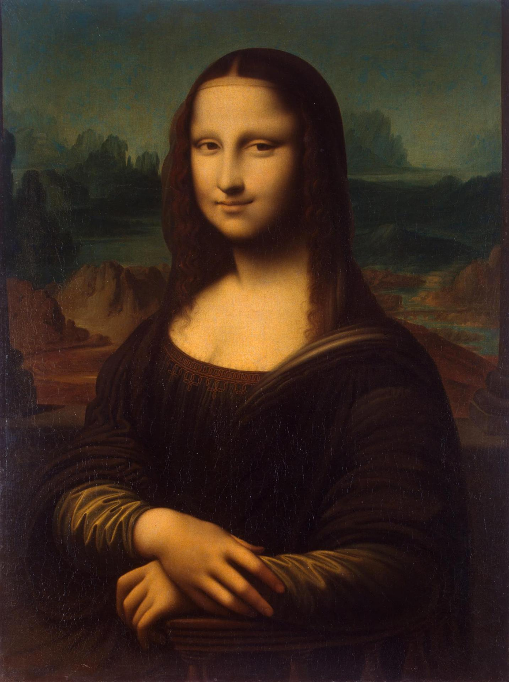
Pass by “Value”
- Thanks Mehran

Slide 88
More Examples

Slide 89
Changed Name
private void run() {
int num = 5;
cow(num);
}
private void cow(int grass) {
println(grass);
}

Slide 90
Changed Name
Run memory
private void run() {
int num = 5;
cow(num);
}
private void cow(int grass) {
println(grass);
}
num
5

Slide 91
Changed Name
Run memory
private void run() {
int num = 5;
cow(num);
}
private void cow(int grass) {
println(grass);
}
num
5

Slide 92
Changed Name
Run memory
private void run() {
int num = 5;
cow(num);
}
private void cow(int grass) {
println(grass);
}
num
5

Slide 93
Changed Name
Run memory
Cow memory
private void run() {
int num = 5;
cow(num);
}
private void cow(int grass) {
println(grass);
}
num
5
grass

Slide 94
Changed Name
Run memory
Cow memory
private void run() {
int num = 5;
cow(num);
}
private void cow(int grass) {
println(grass);
}
num
5
grass
5

Slide 95
Changed Name
Run memory
Cow memory
private void run() {
int num = 5;
cow(num);
}
private void cow(int grass) {
println(grass);
}
num
5
grass
5

Slide 96
Changed Name
Run memory
Cow memory
private void run() {
int num = 5;
cow(num);
}
private void cow(int grass) {
println(grass);
}
num
5
grass
5

Slide 97
Changed Name
Run memory
private void run() {
int num = 5;
cow(num);
}
private void cow(int grass) {
println(grass);
}
num
5

Slide 98
Changed Name
Run memory
private void run() {
int num = 5;
cow(num);
}
private void cow(int grass) {
println(grass);
}
num
5

Slide 99
Changed Name
private void run() {
int num = 5;
cow(num);
}
private void cow(int grass) {
println(grass);
}

Slide 101
Same Variable Name
private void run() {
int money = 5;
retireEarly();
println(money);
}
private void retireEarly(){
int money = 1200000;
println(money);
}

Slide 102
Same Variable Name
run
private void run() {
int money = 5;
retireEarly();
println(money);
}
private void retireEarly(){
int money = 1200000;
println(money);
}
money
5

Slide 103
Same Variable Name
run
private void run() {
int money = 5;
retireEarly();
println(money);
}
private void retireEarly(){
int money = 1200000;
println(money);
}
money
5

Slide 104
Same Variable Name
run
private void run() {
int money = 5;
retireEarly();
println(money);
}
private void retireEarly(){
int money = 1200000;
println(money);
}
money
5
retireEarly

Slide 105
Same Variable Name
run
private void run() {
int money = 5;
retireEarly();
println(money);
}
private void retireEarly(){
int money = 1200000;
println(money);
}
money
5
retireEarly
money
1200000

Slide 106
Same Variable Name
run
private void run() {
int money = 5;
retireEarly();
println(money);
}
private void retireEarly(){
int money = 1200000;
println(money);
}
money
5
retireEarly
money
1200000
1200000

Slide 107
Same Variable Name
run
private void run() {
int money = 5;
retireEarly();
println(money);
}
private void retireEarly(){
int money = 1200000;
println(money);
}
money
5
retireEarly
money
1200000
1200000

Slide 108
Same Variable Name
run
private void run() {
int money = 5;
retireEarly();
println(money);
}
private void retireEarly(){
int money = 1200000;
println(money);
}
money
5
1200000
5

Slide 110

No Methods in Methods
private void run() {
println(“hello world”);
private void sayGoodbye() {
println(“goodbye!”);
}
}
Illegal modifier for parameter goodbye, only final is permitted
Huh?!?

Slide 111
No Methods in Methods
private void run() {
println(“hello world”);
sayGoodbye();
}
private void sayGoodbye() {
println(“goodbye!”);
}

Slide 112
Remember Booleans?

Slide 113
Boolean Variable
boolean karelIsAwesome = true;
boolean myBool = 1 < 2;

Slide 114
Boolean Operations
boolean a = true;
boolean b = false;
boolean and = a && b;
boolean or = a || b;
boolean not = !a;

Slide 115
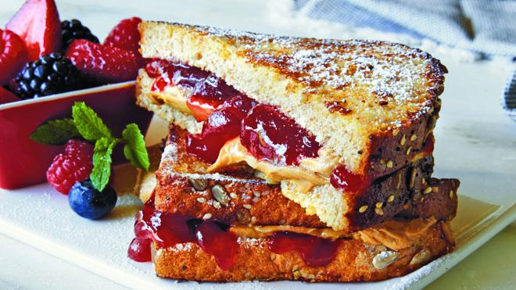

Slide 116
Is Square
public void run() {
for(int i = 1; i <= 100; i++) {
if(isSquare(i)) {
println(i);
}
}
}

Slide 117
Boolean Return
public void run() {
for(int i = 1; i <= 100; i++) {
if(isSquare(i)) {
println(i);
}
}
}
private boolean isSquare(int x) {
double root = Math.sqrt(x);
if(root == Math.floor(root)) {
return true;
} else {
return false;
}
}

Slide 118
Boolean Return
public void run() {
for(int i = 1; i <= 100; i++) {
if(isSquare(i)) {
println(i);
}
}
}
private boolean isSquare(int x) {
double root = Math.sqrt(x);
return root == Math.floor(root);
}

Slide 119
Boolean Return
public void run() {
for(int i = 1; i <= 100; i++) {
if(isSquare(i)) {
println(i);
}
}
}
private boolean isSquare(int x) {
double root = Math.sqrt(x);
return root == (int)root;
}

Slide 120
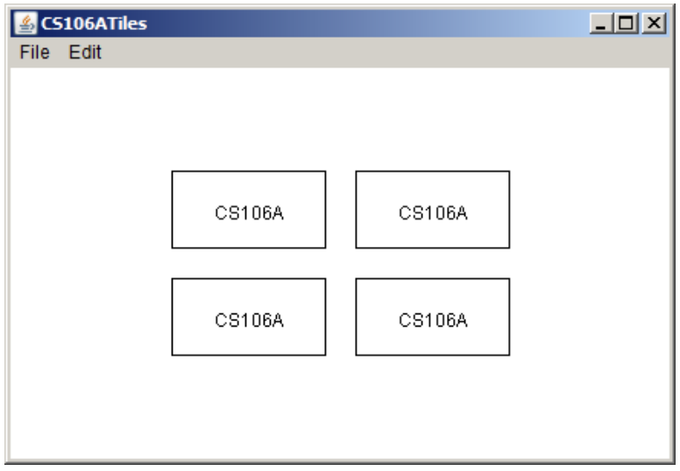
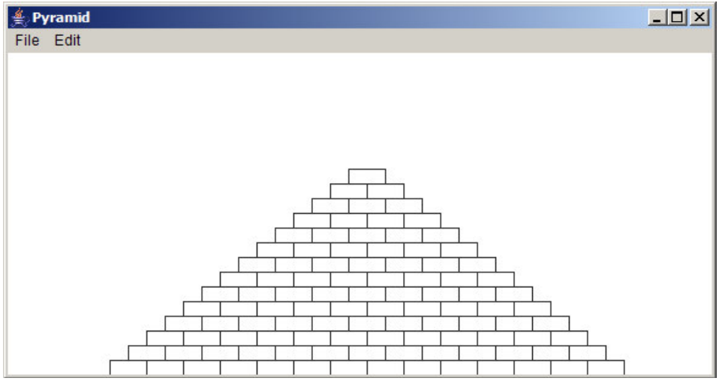
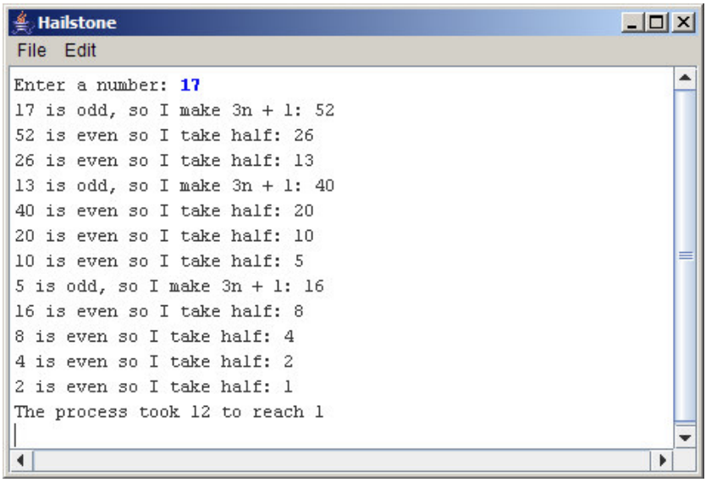

Assn 2
Absolutely
Not necessary
Yes
Odd test?

Slide 122
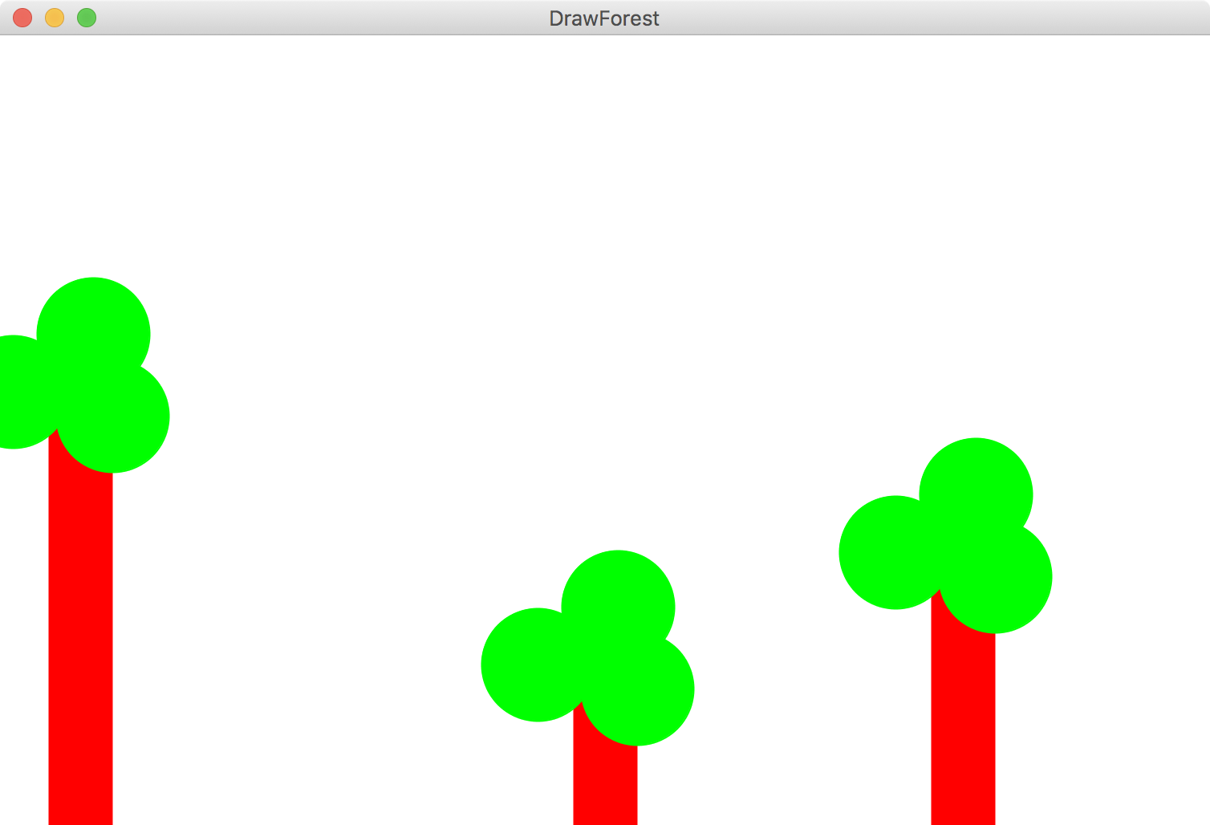

Slide 123
